Slide 1
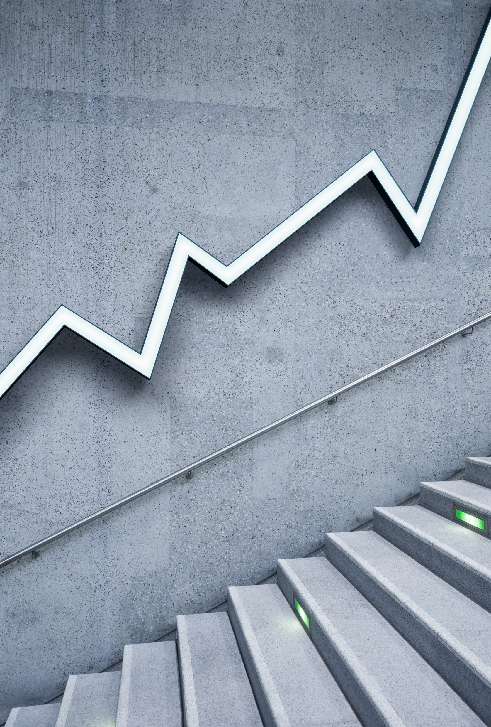
Netflix Stock price prediction
-- By Sravan

Slide 2

Stock price prediction
Stock price prediction is the process of using various methods and data to forecast the future prices of a company's stock in financial markets. This prediction is based on the belief that past stock price patterns, financial information, and other relevant data can provide insights into where a stock's price may be headed.
Here's a brief overview of how stock price prediction works:
Stock price prediction is the process of using various methods and data to forecast the future prices of a company's stock in financial markets. This prediction is based on the belief that past stock price patterns, financial information, and other relevant data can provide insights into where a stock's price may be headed.
Here's a brief overview of how stock price prediction works:
1. Data Collection: Gather historical stock price data, as well as various relevant factors that could impact the stock's price. This can include financial statements, economic indicators, news sentiment, and more.

Slide 3

2. Feature Selection: Identify and select the most important variables or features that are likely to influence stock prices. Common features include price trends, trading volume, company earnings, and macroeconomic factors.
3. Model Building: Develop predictive models using techniques from statistics and machine learning.
Common approaches include linear regression, time series analysis, and more advanced methods like neural networks.
4. Training: Train the chosen model using historical data. The model learns patterns and relationships between the selected features and past stock price movements.
5. Evaluation: Evaluate the model's performance using a separate dataset (validation set) that it hasn't seen before. Common evaluation metrics include Mean Squared Error (MSE), Root Mean Squared Error (RMSE), and Mean Absolute Error (MAE).
6. Prediction: Once the model is deemed satisfactory, use it to make future stock price predictions based on new, incoming data.

Slide 4
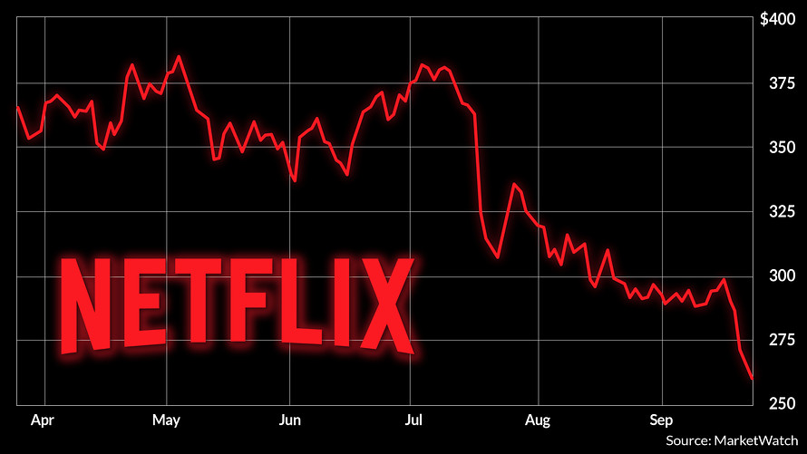

Slide 5
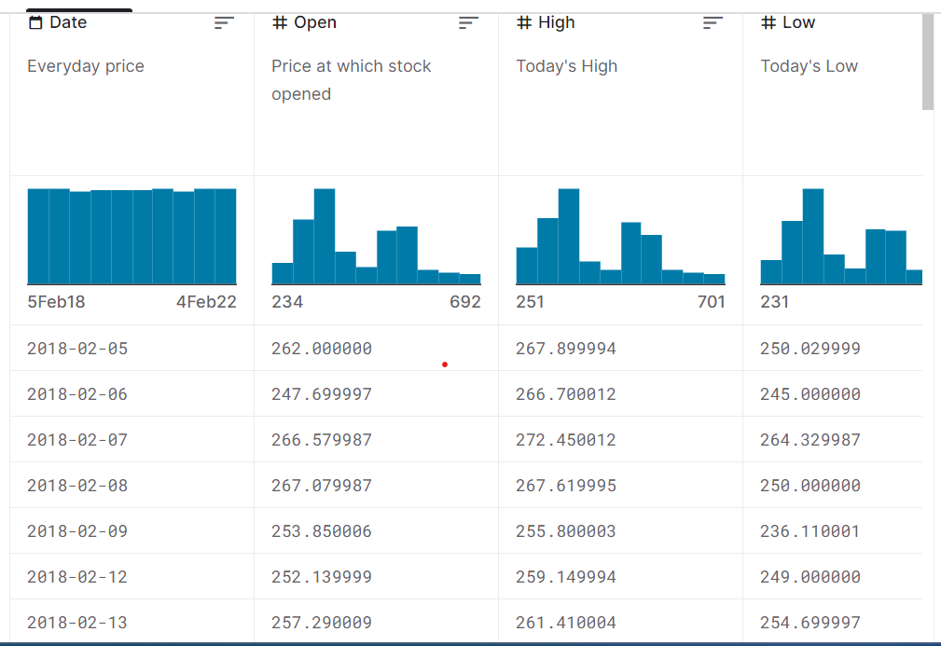
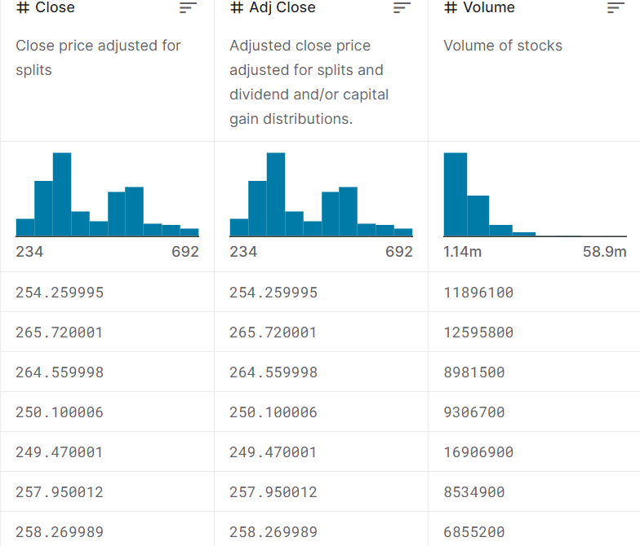

Slide 6
Predicting stock prices is a complex task and involves various factors, including economic conditions, company performance, market sentiment, and external events. Machine learning models are often used to make predictions based on historical data. When predicting stock prices, several features, or variables, are commonly used to provide input to these models. Here, I'll explain some of the key features used In stock price prediction: Feature details: Open Price: The opening price is the price at which a stock starts trading at the beginning of a trading session, typically in the morning when the stock market opens. It is an essential feature because it reflects the initial sentiment and demand for the stock on a given day. The open price can be influenced by overnight news, global events, or pre-market trading activity. Close Price: The closing price is the last traded price of a stock at the end of a trading session, typically in the afternoon when the stock market closes. It is a crucial feature because it represents the final consensus on the stock's value for that day. The close price is often used as the target variable for prediction models. High Price: The high price represents the highest trading price reached by a stock during a particular trading session. It provides insights into the intraday volatility and the stock's potential for price spikes.

Slide 7
Low Price: The low price is the lowest trading price reached by a stock during a trading session. It indicates the lowest level of demand or interest in the stock during the day and can help identify support levels.
Target Variable:
Volume: Trading volume refers to the total number of shares of a stock traded during a particular trading session. It is an essential feature because it reflects the level of market activity and liquidity for the stock. High trading volume can signify increased interest or volatility, while low volume may indicate reduced interest or a lack of liquidity.

Slide 8
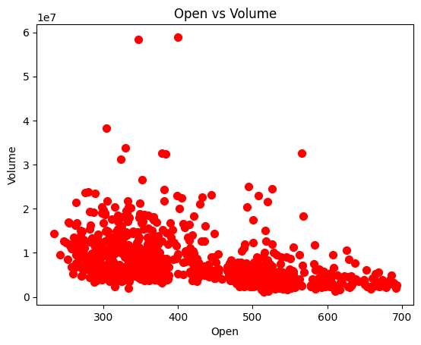
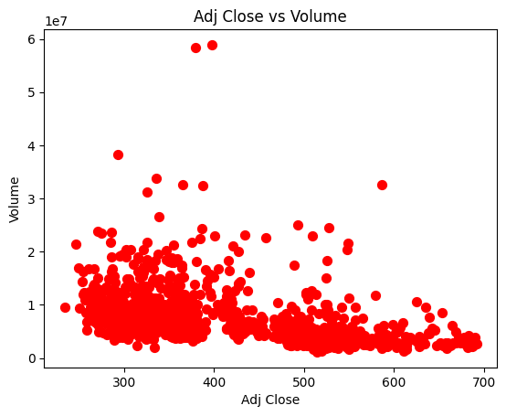
Target VS Features Graph

Slide 9
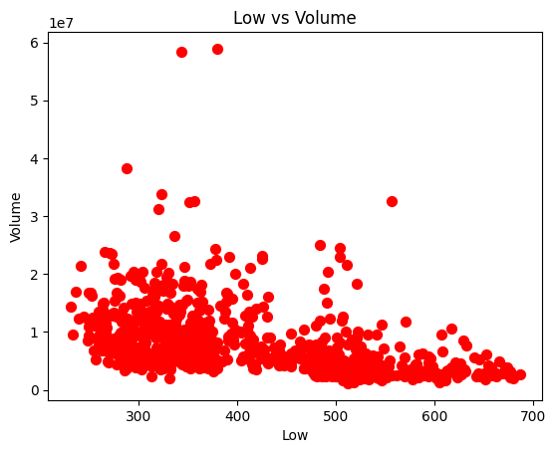
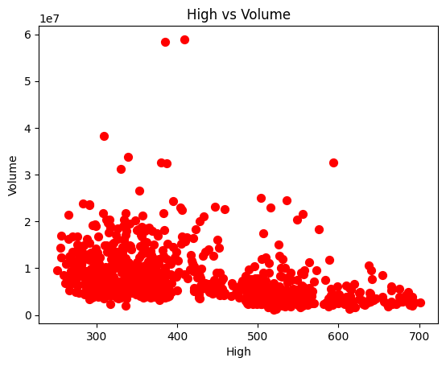

Slide 10
MACHINE LEARNING MODEL
The machine learning models used for this project are:
Linear regression
Support Vector Machine (SVM)
Machine learning models
Logistic regression
K-nearest neighbor(KNN)

Slide 11
LINEAR REGRESSION
Linear regression is a fundamental supervised machine learning technique used for predicting a continuous outcome variable (dependent variable) based on one or more input features (independent variables). It assumes a linear relationship between the inputs and the target variable, aiming to find the best-fit line that minimizes the difference between predicted and actual values.
In essence, linear regression finds coefficients for each input feature to create a linear equation (y = mx + b), where 'y' is the predicted outcome, 'x' represents input features, 'm' are coefficients (weights), and 'b' is the intercept. The process involves using training data to learn these coefficients through methods like ordinary least squares or gradient descent. Once trained, the model can make predictions on new data.
Linear regression is widely used in various fields for tasks like price prediction, trend analysis, and more, but it works best when the relationship between inputs and outputs is approximately linear.

Slide 12
Support Vector Machine (SVM)
Linear regression in the context of Support Vector Machines (SVM) is known as Support Vector Regression (SVR). SVR is a supervised machine learning technique that extends the principles of SVM to solve regression problems, where the goal is to predict continuous numerical values instead of class labels.
In SVR, the objective is to find a hyperplane (linear function) that best fits the data by minimizing the margin of error between the predicted and actual values. Instead of maximizing the margin as in SVM for classification, SVR aims to ensure that most data points fall within a certain margin or epsilon-tube around the predicted line.
SVR employs a loss function that penalizes data points for being outside the margin, and the goal is to minimize this loss while also controlling the complexity of the model through regularization parameters. SVR can be used with different kernel functions, allowing it to capture non-linear relationships when necessary.
Overall, SVR is a powerful tool for regression tasks, especially when dealing with data that may not have a strictly linear relationship between inputs and outputs.

Slide 13
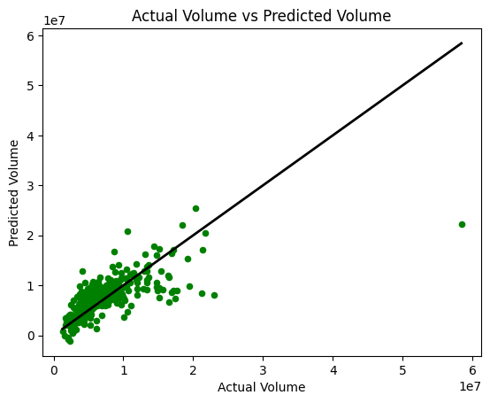
Best Fit Line
ERROR:
Mean Squared Error (MSE): 13975974430293.28711
Mean Absolute Error (MAE): 2368762.89286
Root Mean Squared Error (RMSE): 3738445.45638
PREDICTION:
Enter opening price: 0.99
Enter high price: 0.80
Enter low price: 0.78
Enter closing price: 0.90
Enter Adjusted closing price: 0.48
Predicted volume for your features is: 5889587.10

Slide 14
LASSO REGRESSION
Lasso regression, short for "Least Absolute Shrinkage and Selection Operator" regression, is a linear regression technique used for feature selection and regularization in machine learning. It introduces L1 regularization to the standard linear regression cost function, adding a penalty term that encourages some of the coefficients to become exactly zero. This makes Lasso regression not only a predictive tool but also a feature selection method.
The key idea behind Lasso is to reduce the influence of less important features by effectively eliminating them from the model. As the regularization strength, represented by a hyperparameter (λ), increases, more coefficients are shrunk to zero. This can help create simpler and more interpretable models while improving their generalization performance. Lasso is particularly valuable in situations where you suspect that only a subset of the input features is genuinely relevant for making accurate predictions. It can automatically identify and retain the most informative variables, making it a powerful tool for data dimensionality reduction and feature selection.

Slide 15
RIDGE REGRESSION
Ridge regression is a linear regression technique used in machine learning and statistics to address multicollinearity and overfitting issues in regression models. It adds a regularization term, often represented as L2, to the linear regression's cost function. This regularization term penalizes the magnitude of the coefficients, discouraging them from becoming too large.
In Ridge regression, the objective is to minimize the sum of squared differences between the predicted values and the actual values (the standard linear regression objective) while also keeping the sum of the squared coefficients as small as possible. The regularization term, controlled by a hyperparameter called lambda (λ), balances these objectives. A higher λ value leads to more significant shrinkage of the coefficient values.
Ridge regression is particularly useful when dealing with datasets with high multicollinearity, where predictor variables are correlated. It helps stabilize coefficient estimates and mitigates the risk of overfitting, making it a valuable tool for improving the generalization performance of regression models.

Slide 16
KNN REGRESSION
K-Nearest Neighbors (KNN) regression is a machine learning algorithm used for predicting continuous values, making it suitable for regression tasks. KNN works on the principle of similarity: it predicts the value of a new data point by considering the K nearest data points (neighbors) in the training dataset. In regression, these neighbors' target values are averaged to make the prediction.
Here's how KNN regression works:
1. Choose the number of neighbors (K) to consider.
2. Calculate the distances between the new data point and all data points in the training set, often using methods like Euclidean distance.
3. Select the K nearest neighbors.
4. Average their target values to predict the value for the new data point.
KNN regression is a non-parametric and instance-based algorithm, meaning it doesn't make underlying assumptions about the data's distribution. It can adapt to complex and nonlinear relationships but may be sensitive to the choice of K and the distance metric. KNN is useful in scenarios where local patterns in the data are more relevant than global trends, such as in spatial analysis or time series forecasting.

Slide 17
Bootstrap Method
The Bootstrap Method is a resampling technique widely used in statistics and machine learning for estimating the sampling distribution of a statistic or making inferences about a population based on a sample of data. It involves creating multiple resamples (bootstrap samples) from the original dataset by randomly selecting data points with replacement.
Here's how the Bootstrap Method works:
1. Start with a dataset of size N.
2. Create B (typically, thousands) bootstrap samples by randomly selecting N data points with replacement from the original dataset. This means that some data points may appear multiple times in a bootstrap sample, while others may not appear at all.
3. Calculate the statistic of interest (e.g., mean, median, standard error) for each of these B bootstrap samples.
4. The collection of statistics forms the bootstrap sampling distribution, which can be used to estimate the uncertainty associated with the statistic, construct confidence intervals, or perform hypothesis testing.
The Bootstrap Method is valuable when analytical methods for estimating the distribution of a statistic are complex or unavailable. It provides a robust and computationally efficient way to approximate the sampling distribution, making it a versatile tool for statistical analysis.

Slide 18
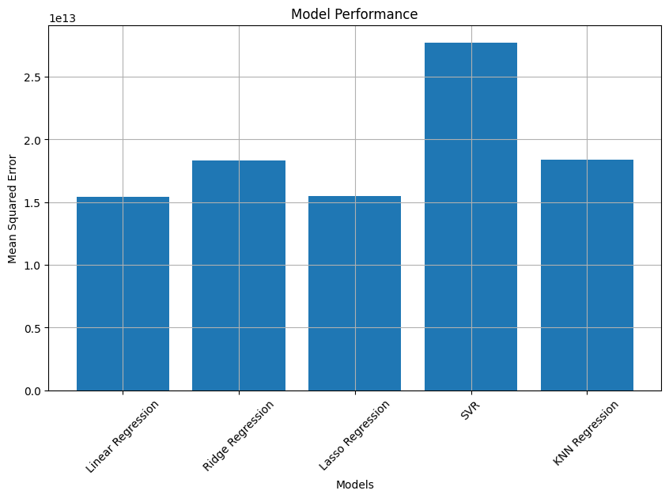
Conclusion
The Best Model (Bootstrap) is Linear Regression with a Mean MSE of 15411068344867.20

Slide 19
THANK YOU

